Slide 1
Introduction to University Life
Geography of Sakarya Province

Slide 2
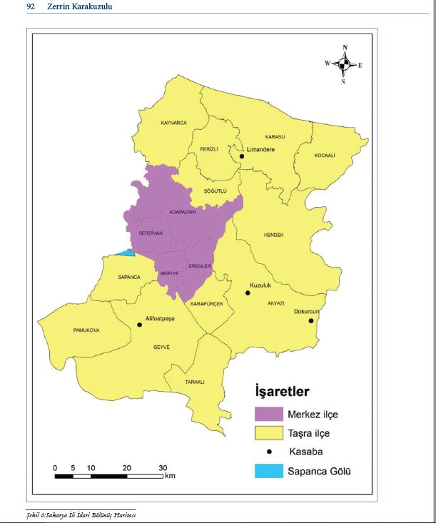
Geography of Sakarya Province
Located in the region referred to as 'Bithynia' by Greek and Latin writers, Sakarya has historically been an important route connecting Asia to Europe.
The administrative unit of Sakarya Province was established on December 1, 1954.
Sakarya Metropolitan Municipality was founded by a decree accepted on January 14, 2000, and published in the Official Gazette on March 6, 2000.
Sakarya has a total of 16 districts, four of which are central (Adapazarı, Serdivan, Erenler, and Arifiye). The other districts are Kaynarca, Ferizli, Söğütlü, Karasu, Kocaali, Hendek, Akyazı, Karapürçek, Sapanca, Pamukova, Geyve, and Taraklı

Slide 3
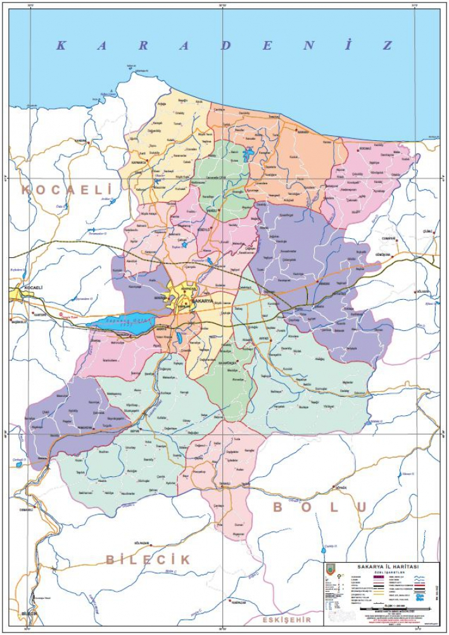
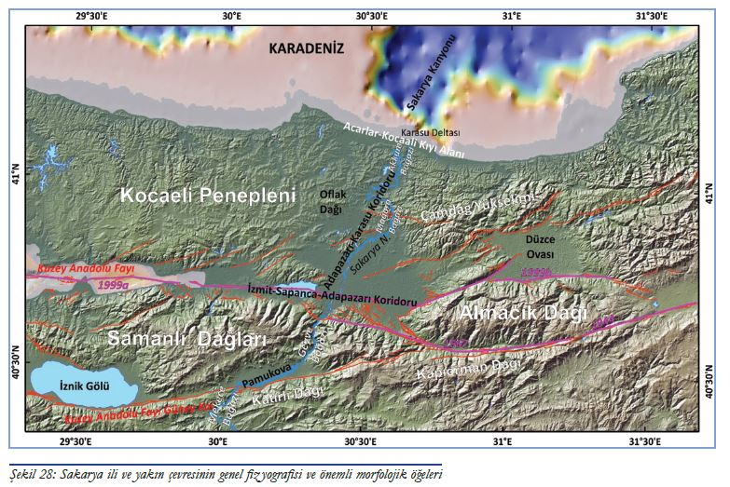
When examining the geographical distribution of Sakarya Province, it is observed that its territory spans three geographical sections. In the Çatalca-Kocaeli section: the districts of Kaynarca, Söğütlü, Ferizli, Sapanca, Karapürçek, and Karasu. In the Western Black Sea section: the district centers and some villages of Kocaali and Taraklı, as well as some villages and towns of Akyazı and Hendek. The remaining areas of the province are located in the Southern Marmara section.
Due to its varied geographical features, Sakarya Province exhibits significant diversity and differences in social, economic, and cultural structures.

Slide 4
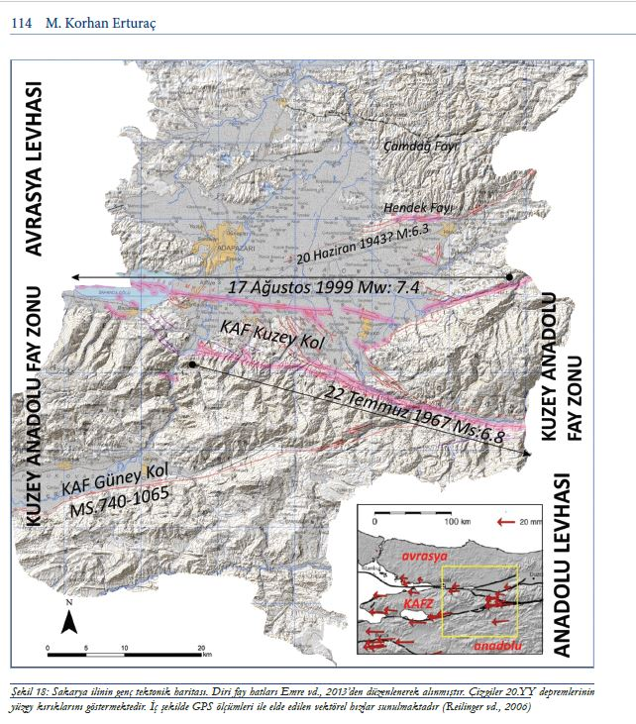
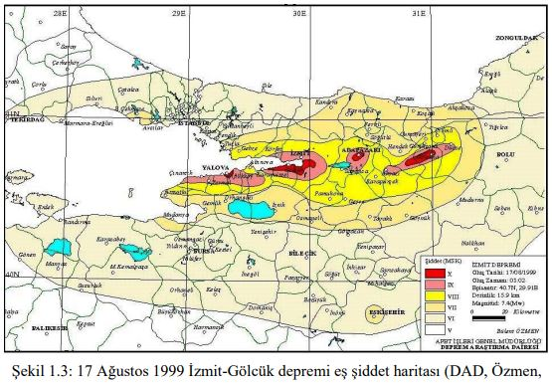
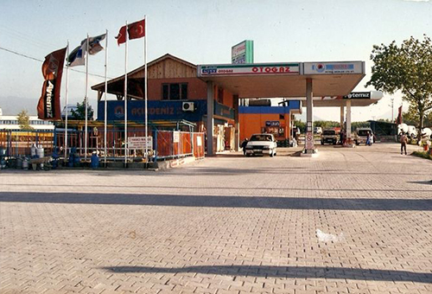
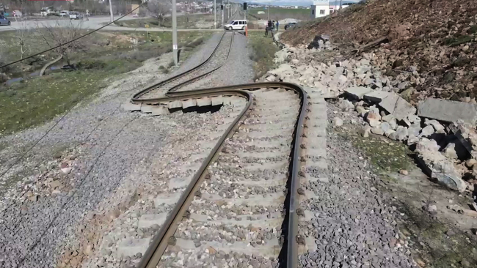
Sakarya İlinin Tektonik Yapısı
Sakarya Province is controlled by active fault lines developed within the North Anatolian Fault Zone (NAFZ). The northern part of the province lies within the Eurasian Plate, the central part within the NAFZ, and the southern part within the Anatolian Plate. The morphological distinctiveness of the active faults is quite prominent. This effect can be observed in formations such as the Gulf of Izmit, Sapanca Lake, Adapazarı Plain (tectonic corridor), Mudurnu River Valley, and Pamukova.
Most of the active fault lines within Sakarya Province were fractured by two major earthquakes that occurred in the last century (July 22, 1967, and August 17, 1999).The August 17, 1999 earthquake is one of the most devastating earthquakes in Turkey's history and caused extensive destruction and loss of life in Sakarya.

Slide 5
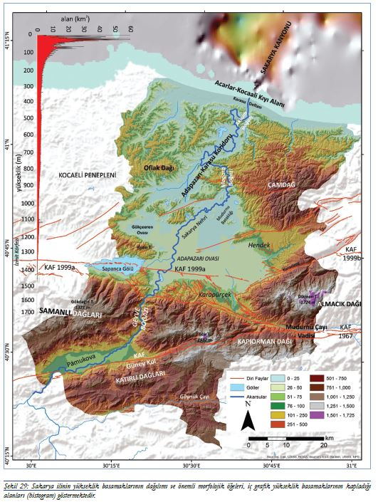
Morphology
The main morphological units of Sakarya consist of the extensions of the Kocaeli Plateau and Çamdağ in the north, the Samanlı Mountains and Pamukova depression in the south, and the Adapazarı Plain, Akova, and Sapanca Lake located between these units.
The Sakarya River, which flows in a southwest-northeast direction, intersects these morphological units. Sapanca Lake is 31 meters above sea level and has an area of 47 km².
The highest point in Sakarya is Elmacık Mountain at 1,730 meters, and the lowest point is the Black Sea coast at 0 meters.
Plains cover 21% of the province.

Slide 6
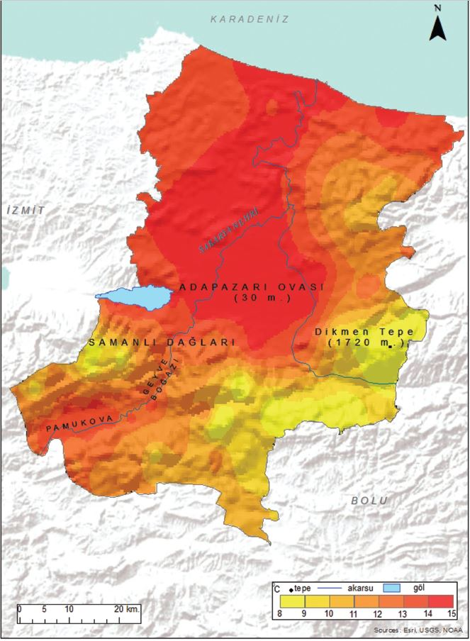
CLIMATE
According to data from meteorological stations in and around Sakarya Province, the annual average temperatures are 14.6°C in Adapazarı, 13.7°C in Geyve, and 14.1°C in Sapanca. Due to its higher altitude (100 m) and relatively less exposure to marine influence, Geyve has lower temperatures compared to Adapazarı (30 m) and Sapanca (30 m).
Monthly average temperatures reach their lowest values in January (Adapazarı 6.1°C, Geyve 4.0°C, Sapanca 5.4°C), rise above the annual average in May, and reach their highest values in July (Adapazarı 23.6°C, Geyve 23.4°C, Sapanca 23.4°C).
In Sakarya, significant temperature differences occur between the plain areas and the surrounding plateaus and mountainous regions due to differences in elevation, aspect, slope gradient, and orographic alignment. It is observed that there is a temperature difference of approximately 2°C between the coastal and inland areas in the distribution of annual average temperatures. Due to the maritime effect, coastal areas experience higher temperatures (Karasu, 14.8°C), while inland areas are relatively cooler due to continental influence (Taraklı, 12.1°C). There is a temperature difference of 6-7°C between the plain areas and the surrounding plateau surfaces and mountainous regions.

Slide 7
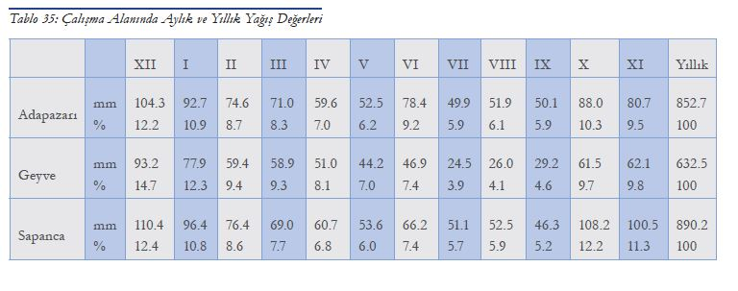
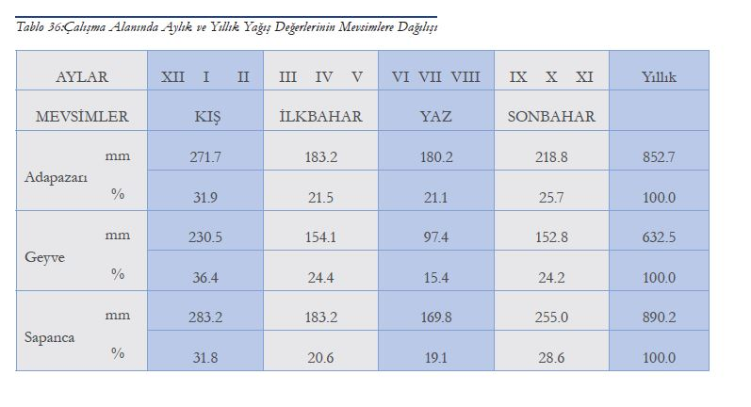
PRECIPITATION
The annual average precipitation amounts recorded by meteorological stations in Sakarya are 852.7 mm in Adapazarı, 890.2 mm in Sapanca, and 632.5 mm in Geyve.
Winter is the season with the most precipitation, while summer has the least. There is a significant difference in annual average precipitation among the stations, which is mainly due to Sakarya's geographical position relative to the sea and its geomorphological features.
Precipitation amounts increase from south to north and from plain areas towards mountainous regions with higher elevations.
The areas with the least precipitation are in the south, around Pamukova and its surroundings. The annual average number of rainy days is 133 days in Adapazarı, 103 days in Sapanca, and 106 days in Geyve.

Slide 8
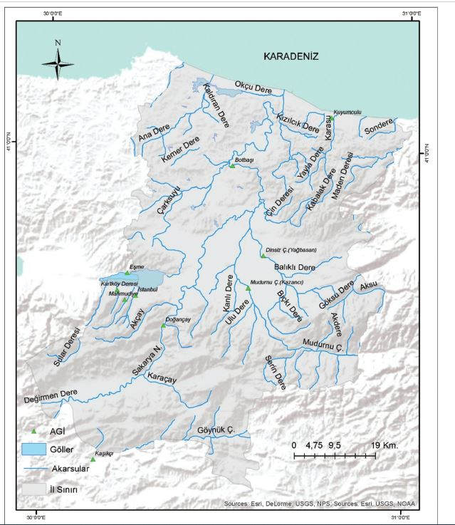
HYDROGRAPHY
The hydrographic characteristics of a region (rivers, lakes, groundwater, etc.) are shaped by numerous factors, primarily climate, especially precipitation. Many streams that mostly flow into the Sakarya River, along with lakes and a high groundwater level, constitute the water resources of Sakarya.
The primary river in Sakarya Province is, without a doubt, the Sakarya River, which also gives its name to the province. Known as Sangarios in ancient times, this river, along with its tributaries, drains a significant portion of the province. It is the third longest river in Turkey after the Kızılırmak and Yeşilırmak rivers and the longest river in northwestern Anatolia.
The Sakarya River is 810 km long, with a basin area of 58,160 km². Its major tributaries, from upstream to downstream, include Seydi Stream, Porsuk Stream, Ankara Stream, Kirmir Stream, Karasu Stream, Göksu Stream, Göynük Stream, Mudurnu Stream, and Çarksuyu Creek. Çark Stream, which passes through the city center, carries the excess waters of Sapanca Lake into the Sakarya River.

Slide 9
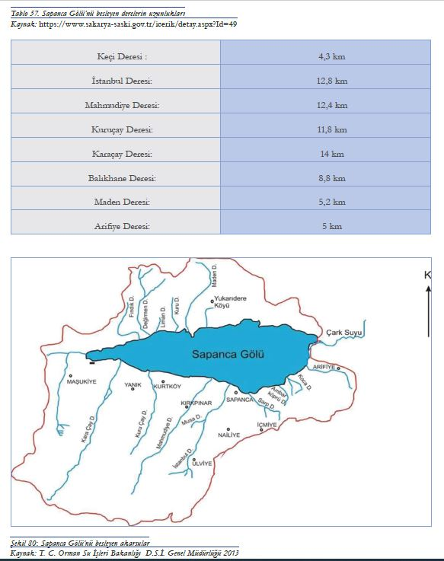
LAKES
The lakes in Sakarya include Sapanca Lake, Poyrazlar Lake, Taşkısığı Lake, Küçük Akgöl, Büyük Akgöl, and Acarlar Floodplain Forest.
Sapanca Lake, a tectonic lake located east of the Gulf of Izmit, has a length of 16 km in the east-west direction, a maximum width of 5 km in the north-south direction, and a surface area of approximately 47 km². The total shoreline length of the lake is 39 km, of which 13 km lies within the Kocaeli province and 26 km within Sakarya Province.
The lake basin covers an area of 251 km². Sapanca Lake has an average depth of 36 meters and a maximum depth of 52 meters. The freshwater in Sapanca Lake is used as the main drinking water source for Adapazarı and surrounding districts. The lake's waters are also used for industrial and irrigation purposes.
The streams feeding the lake include Keçi Stream, Istanbul Stream, Kurtköy Stream, Mahmudiye Stream, Yanık Stream, Karaçay Stream, Balıkhane Stream, Çifteçınar Stream, Tuzla Stream, Kanlıtarla Stream, Eşme Stream, Kuru Stream, Maden Stream, Çatalölü Stream, Altıkuruş Stream, Harmanlar Stream, Aygır Stream, Cehennem Stream, and Arifiye Stream. The lake discharges into the Sakarya River through Çarksuyu Stream on its eastern side, which is the lake's only outlet.
Located approximately 10 km from the city center, Poyrazlar Lake (Adapazarı) is one of the province's most important picnic areas. Acarlar Floodplain Forest (Kaynarca-Karasu), located 2 km from the Black Sea, is one of the city's most popular tourist attractions due to its unique flooded forest feature.

Slide 10
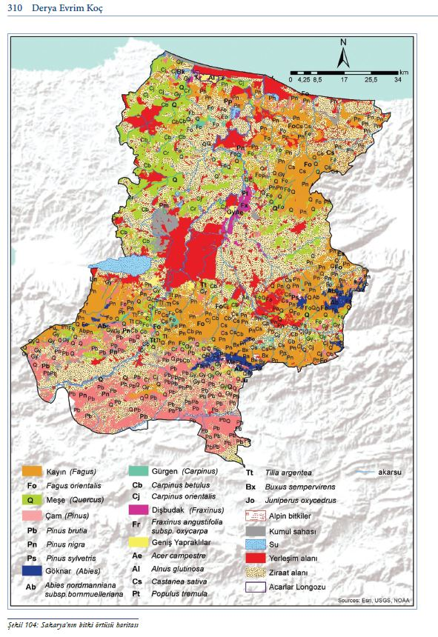
VEGETATION
Sakarya is located within the Euxine province of the Euro-Siberian phytogeographic region. The forest formation is the most widespread type of vegetation. In the lower and coastal zones of Sakarya, deciduous trees and shrubs are common, while coniferous forests grow in higher, colder, and more humid areas.
The forests in Sakarya consist mainly of broad-leaved moist forests. In areas where forest vegetation has been degraded, hazelnut cultivation is commonly observed. In the Adapazarı Plain, forests have been cleared and converted into agricultural land. Due to its ecological conditions, Sakarya has favorable conditions for the development, preservation, and, if not disturbed, regeneration of its natural vegetation.
The tree species commonly found across Sakarya Province include beech, fir, pine, oak, ash, elm, chestnut, and linden.

Slide 11
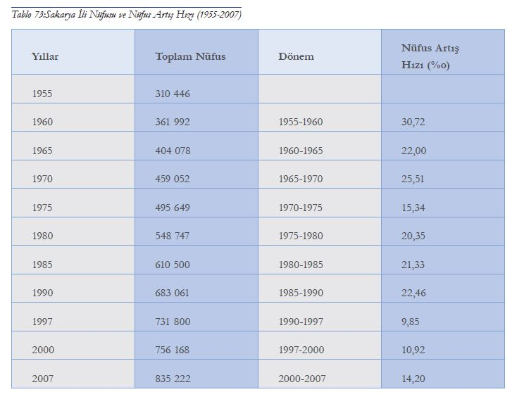
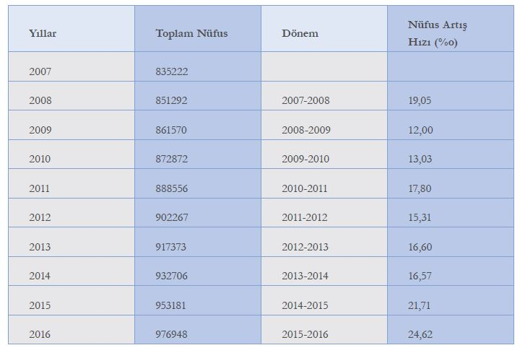
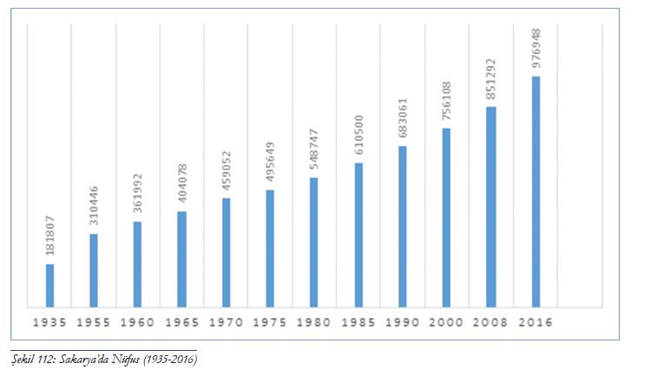
POPULATION
Sakarya, one of Turkey's significant cities in terms of urbanization and industrialization, became a province in 1954. The establishment of major industrial facilities such as the Agricultural Equipment, Wagon, and Sugar Factories, along with migration from east to west and from rural areas to urban centers, has contributed to Sakarya’s continuous population growth. However, the August 17, 1999 earthquake, which caused significant loss of life, the destruction of numerous buildings, damage to city infrastructure, and other factors, slowed down urban development.
Although there was an increase in migration out of the city immediately following the earthquake, the city's reconstruction process, major government investments, and its designation as a metropolitan municipality have led to significant population growth. The increase in the student population at Sakarya University has also been a major factor contributing to population growth since the 2000s.

Slide 12
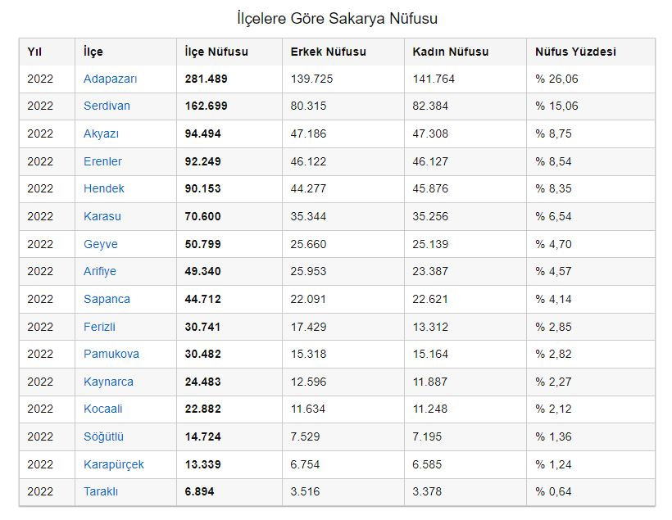
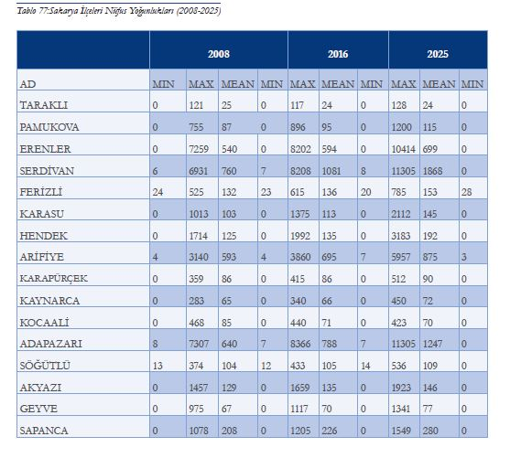
Since the adoption of the address-based registration system in 2007, it has become possible to analyze issues related to Sakarya’s population and population growth more accurately. Since 2007, Sakarya has consistently stood out as a city with a population growth rate above the national average.
Looking at the urbanization rates of Sakarya’s population from past to present, in 1935, a large portion of the population (83.62%) lived in rural areas. With the acceleration of urbanization after 1980, the urban population increased rapidly, and today, 67.38% of the population resides in cities.
Another issue that needs to be examined, in addition to population growth, is population density and distribution. When examining the population density of 1935, the districts with the highest population density were Adapazarı (93), Erenler (81), Serdivan (67), Arifiye (56), Söğütlü (47), Sapanca (43), and Hendek (40), while the districts with the lowest density were Taraklı (15), Karasu (15), Karapürçek (22), and Kaynarca (22) (Table 5).By the year 2000, Serdivan became the district with the highest population density (564), followed by Adapazarı (534), Erenler (465), and Arifiye (426).

Slide 13
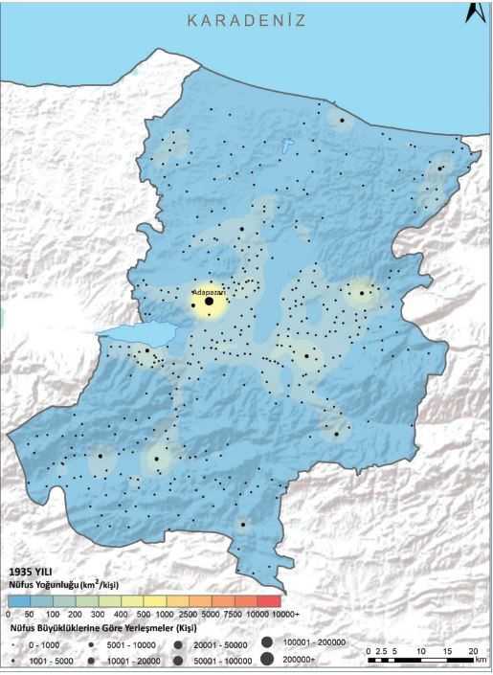
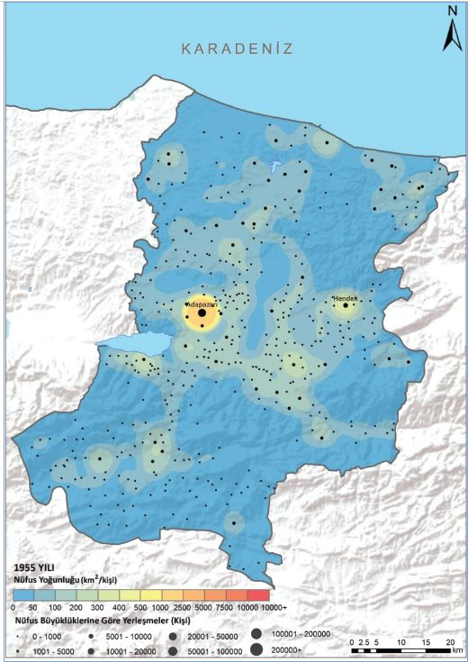
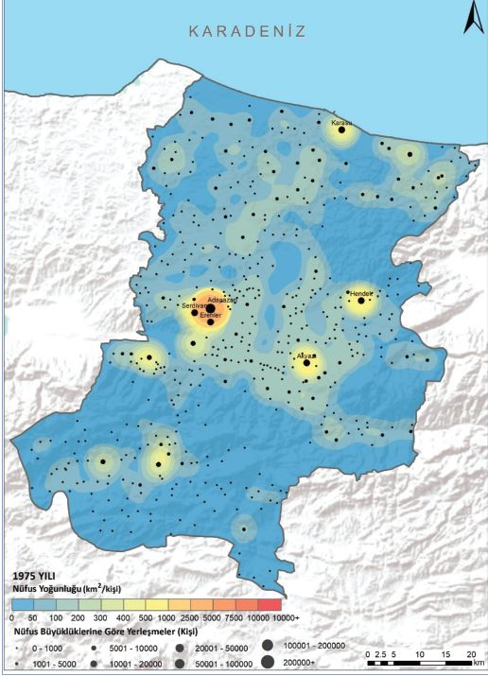
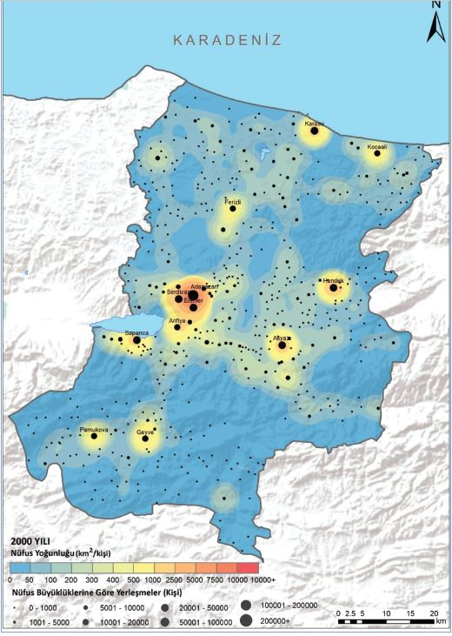
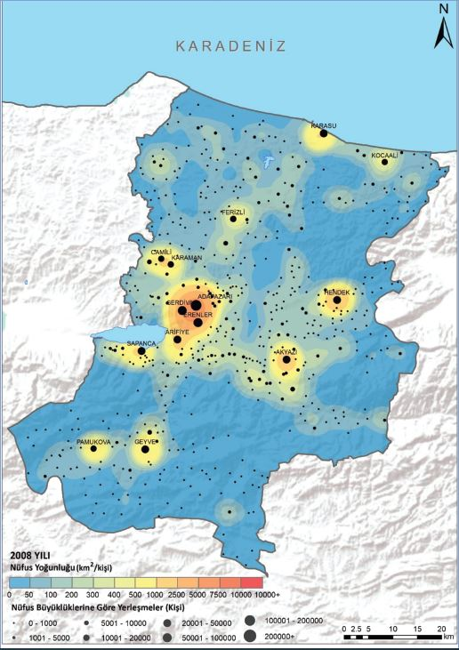
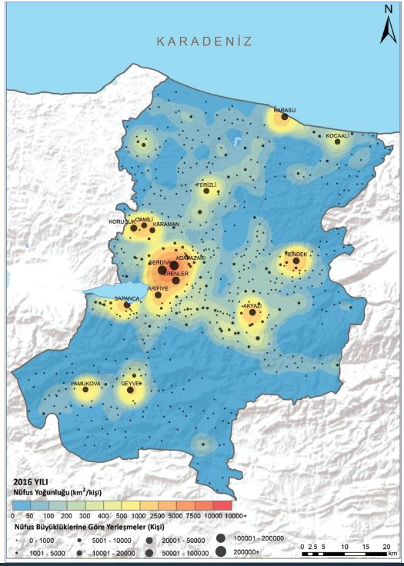
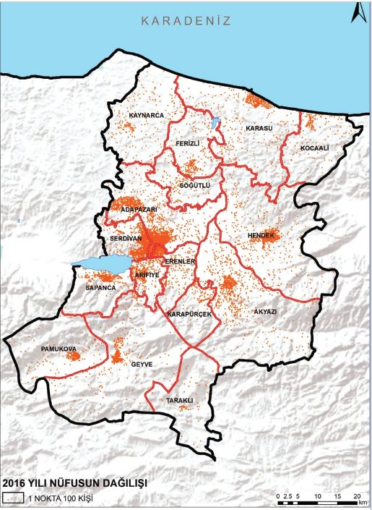
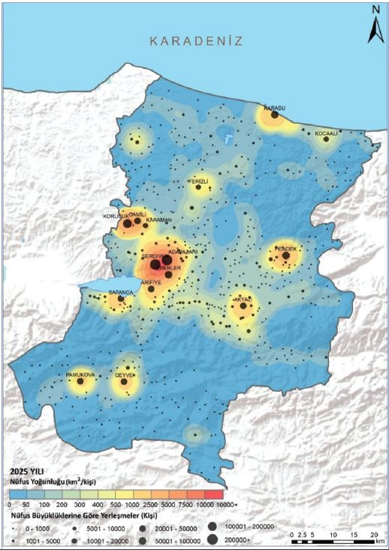

Slide 14
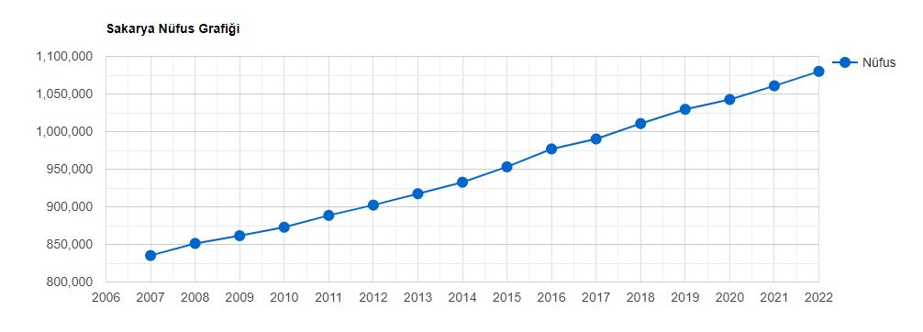
In 2018, Sakarya became a city with a population of one million, reaching 1,010,700 people. By 2022, the population had increased to 1,080,080, with 50.13% (541,449) male and 49.87% (538,631) female.
In 2007, Sakarya had a population density of 171 people per square kilometer, which increased to 221 people per square kilometer by 2022.

Slide 15
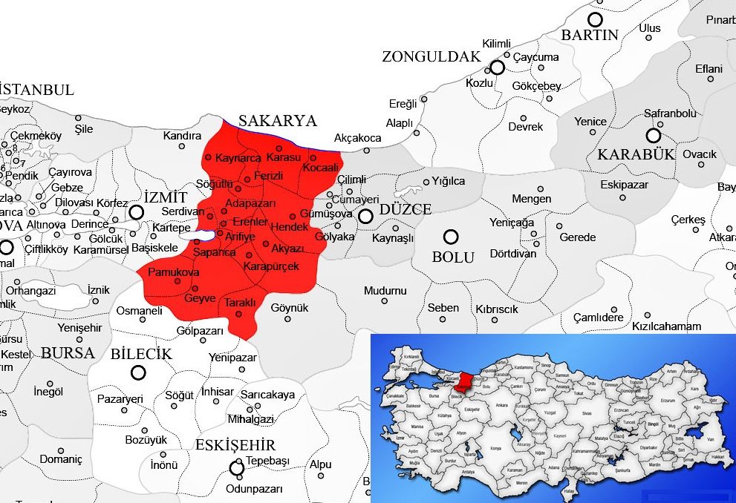
SETTLEMENT GEOGRAPHY
Sakarya Province, located in the eastern part of the Çatalca-Kocaeli section of the Marmara Region, is bordered by the Black Sea to the north, Izmit to the west, Düzce to the east, Bilecik to the south, Bursa to the southwest, and Bolu to the southeast. This region, which has been home to various civilizations since ancient times, came under Turkish rule at the beginning of the 1300s.
The history of settlement in the city of Adapazarı and its immediate surroundings does not date back very far. Although it is located on the main transportation route extending from Istanbul to Anatolia, the first settlements in the area began during the Ottoman period due to unfavorable geographical conditions for settlement.
Adaköy, which formed the nucleus of the city of Adapazarı, was established in the 16th century. In the following years, the settlement, which developed as a marketplace, began to be called "Ada Pazarı" (Island Market). Since those coming to the market from the east had to cross the Sakarya River and those coming from the west had to cross Çark Stream, the impression of a place surrounded by water led to the area being called an "island." The marketplace function contributed to this settlement becoming a commercial center in the 19th century.
In 1868, a municipal organization was established under the name of "Adapazarı Municipality". After the 1877-78 Ottoman-Russian War, its population increased and the area it covered expanded with the migration from the Caucasus and the Balkans. With the law accepted in the Turkish Grand National Assembly on June 17, 1954, Sakarya Province was established with Adapazarı as its center, after being separated from Kocaeli Province.

Slide 16
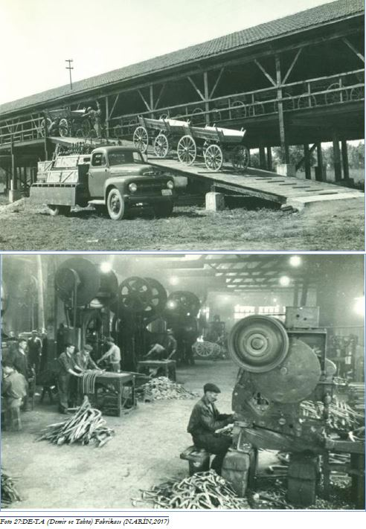
The urbanization process of Adapazarı, which was established and developed based on its commercial function, accelerated in the 1900s with the opening of industrial facilities. This movement began with the Silk Cocoon Factory and flour mills and continued with the establishment of the DE-TA (Iron and Wood) Factory in 1914 to meet the army's need for cannon carriages and wheels. This factory was renamed the Turkish Agricultural Equipment Institution (TZDK) in 1943 under National Protection Law No. 3780.
The Adapazarı Army Equipment Heavy Maintenance and Repair Factory, opened in 1943, the leather factory in 1945, the sugar factory in 1950, and the wagon workshop in 1951 marked the beginning of Adapazarı’s transformation into an industrial city.
With the establishment of the automotive industry in the early 1970s, motor vehicles began to be used in urban transportation. These investments accelerated industrial development in Adapazarı. Some of the factories located within the city began relocating along the Istanbul-Ankara road after it was rerouted outside the city, leading to the city's expansion southward. Modern industrial zones were established along this new development axis. The Organized Industrial Zone, which began its establishment in 1976, became fully operational in 1993, transforming Adapazarı into a full-fledged industrial city

Slide 17
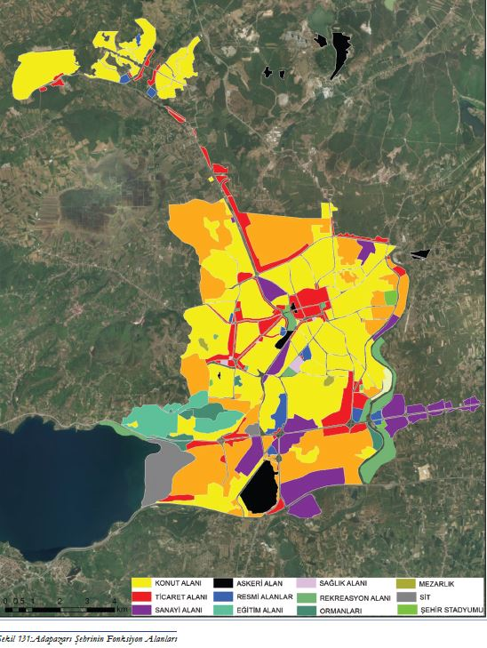
Between 1982 and 1992, the Sakarya Faculty of Engineering and the Vocational School, both affiliated with Istanbul Technical University, formed the foundation of Sakarya University, which was established on July 3, 1992. The rapidly developing university after 1990 added a new function to the city. During these years, the city expanded westward, merging with settlements in the area where the university was established.
By the late 1990s, the city's population exceeded 200,000, including surrounding areas such as Serdivan, Erenler, Arifiye, Güneşler, Nehirkent, Yazlık, and Hanlı. During the Marmara earthquake of August 17, 1999, with a magnitude of 7.4, 27.04% of the residences in Adapazarı were heavily damaged, and 3,694 people lost their lives.
In an effort to accelerate the city's recovery after the earthquake, it gained metropolitan status by the Council of Ministers’ decree No. 593 on March 6, 2000. Since most of the damaged buildings were on the unstable plain, the city's administrative center and new development area were relocated to the Yenikent area, approximately 10 km northwest of the city, where the ground is more stable.
Villages in this area, such as Karaman, Korucuk, and Camili, developed rapidly and became part of the city. In terms of the spatial distribution of urban functions, commercial areas are concentrated in the city center around Atatürk Boulevard, Sakarya Street, Yeni Cami Boulevard, Ankara Street, and Çark Street. This area has remained important as a commercial hub since the city's founding. Uzun Çarşı, located here, is one of the city's symbols, standing strong despite having experienced several earthquakes.
With the city's growth, new commercial axes have emerged. New commercial areas have appeared in Serdivan and its surroundings, where educational functions have developed following the establishment of the university. Muhsin Yazıcıoğlu Boulevard, Bağlar Street, and Medeniyet Boulevard are prominent as areas where commercial activities are concentrated.

Slide 18
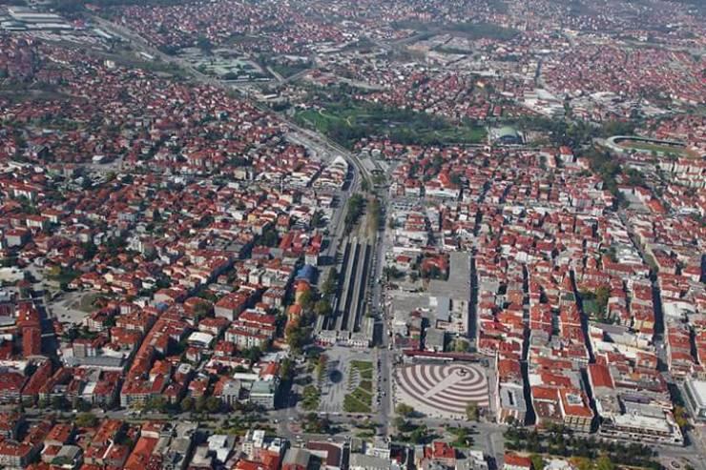
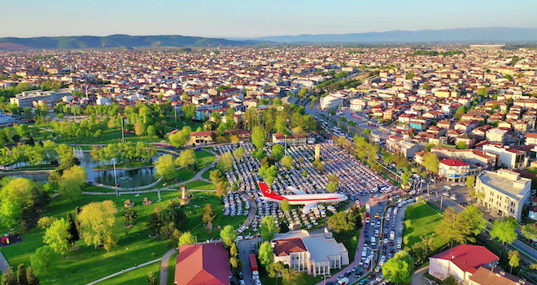
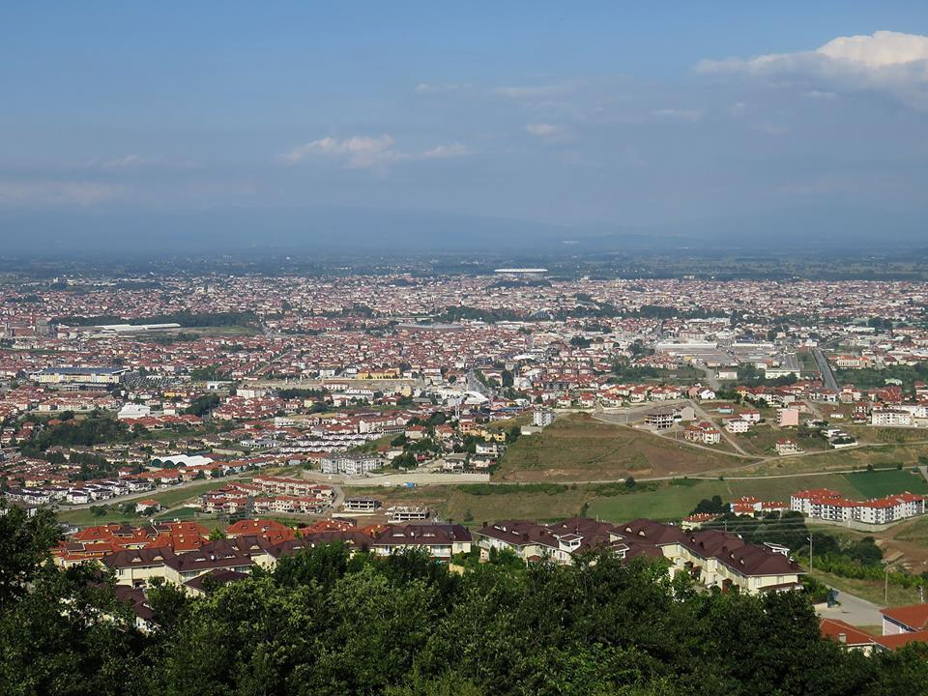
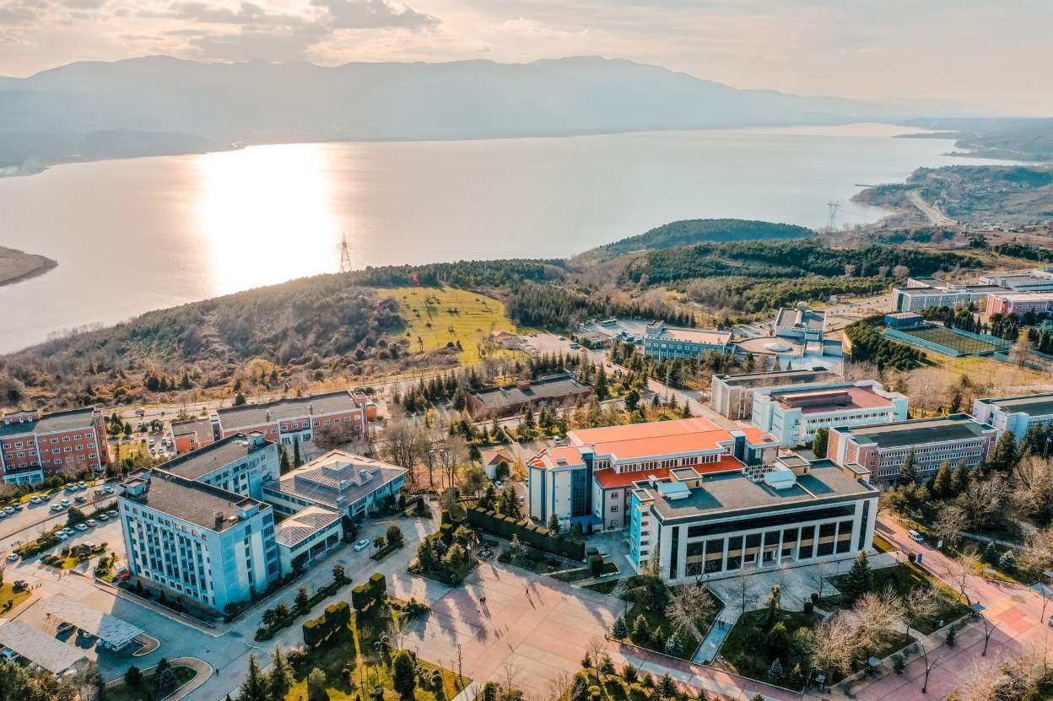

Slide 19
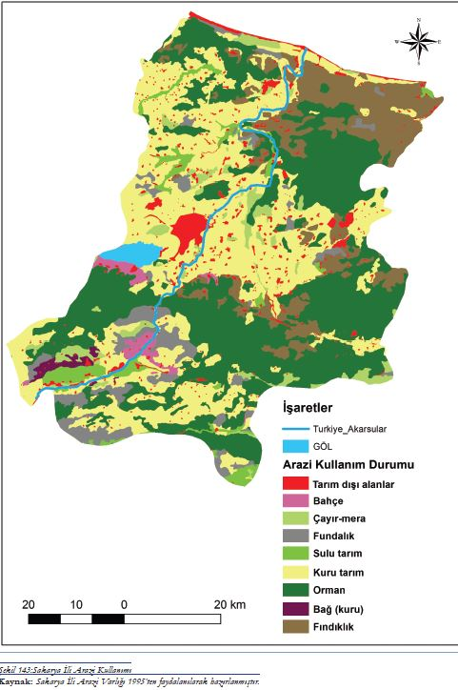
AGRICULTURE
In the historical development process, agriculture and agriculture-based trade have played a very important role in the establishment and growth of almost all settlements in Sakarya Province. The agricultural potential of the province and its surroundings, as indicated by place names in Adapazarı derived from agricultural markets (such as onion market, potato market), highlights the importance of agriculture in opening the area to settlement.
In his research on Sakarya and its surroundings' contributions to meeting Istanbul's needs from the 16th century to the early 20th century, Bilgin states that onions, quinces, and chickens were sent to the palace kitchen from Sakarya. In addition to these products, some of the essential needs of the state, especially during military campaigns, such as wheat, flour, and barley, were also supplied from Sakarya and its surroundings. Thus, agriculture has been one of the most important economic activities for Sakarya Province throughout history.
The share of the agricultural sector in the economy is 14.5% in Turkey overall, 5.2% in the Marmara Region, and 20.5% in Sakarya. While the agricultural sector accounts for approximately 8.6% of GDP in Turkey, in Sakarya, it has a 24% share, acting as a resource provider for the industry (Sakarya Provincial Environmental Status Report, 2011: 12-13). The proportion of those employed in agriculture to total employment in Sakarya is 51.9%. In terms of sectoral production value in the province, animal production ranks first with a share of 50.9%, followed by fruit production with 35.6%, field crop production with 8.3%, and vegetable production with 5.1% (Sakarya Provincial Directorate of Agriculture Annual Activity Summary, 2017).
In addition to maize as the main crop, field crops such as wheat, sugar beet, vetch, alfalfa, and sunflower, as well as garden crops like cabbage, lettuce, tomatoes, peppers, squash, watermelon, and fresh beans, hold significant places in agricultural production. Alongside field crops and vegetables, fruit growing is also an intensive activity in the province. The most important activities in fruit production include hazelnut cultivation and viticulture, followed by apple, pear, quince, and cherry production.

Slide 20
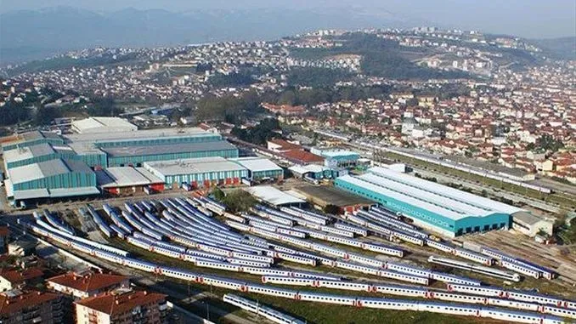
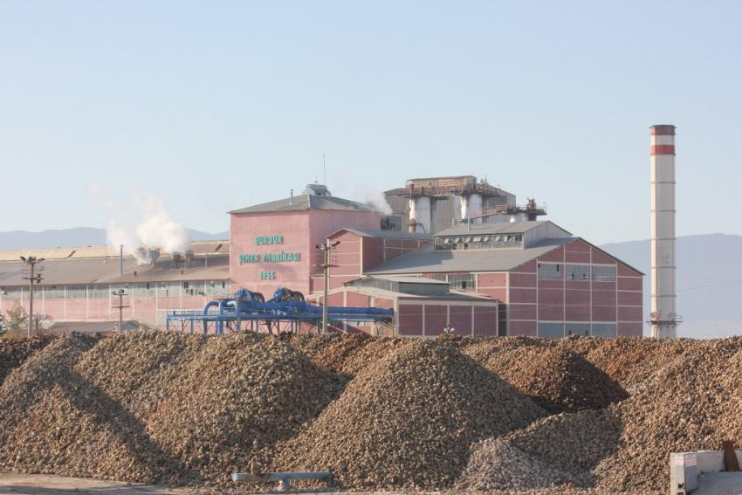
INDUSTRY
During the Ottoman period, the agricultural characteristics of the Adapazarı plain and its surroundings, its forest wealth, and its proximity to Istanbul, as well as its function as a market for the nearby areas, facilitated the presence of traditional manufacturing activities. However, the traditional production sites located in the neighborhoods of the city during this period gradually disappeared in the Republican Era. Industrial facilities such as TZDK, the Military Heavy Maintenance Factory, and the Tank Pallet Factory, initially located in or near the city center and close to the railway line, were moved outside residential areas.
The Wagon Factory, established in 1951, and the Sugar Factory, established in 1953, were built outside the city. Over time, with the construction of worker housing and social facilities in the empty areas surrounding these factories, new residential areas, such as Şeker Neighborhood and Mithat Paşa Neighborhood, were established.
During this period, industry in Sakarya mainly consisted of small-scale manufacturing activities suited to traditional production methods. This is reflected in the neighborhood names, such as Tığcılar, Semerciler, Hasırcılar, Yağcılar, Çıracılar, and Pabuççular in Adapazarı, which were the first settlements for people engaged in these trades.

Slide 21
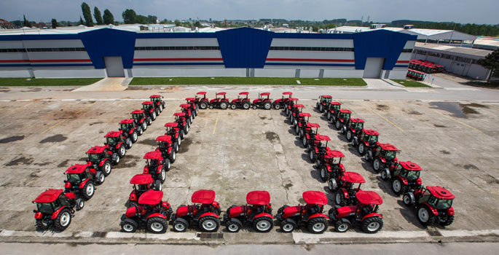
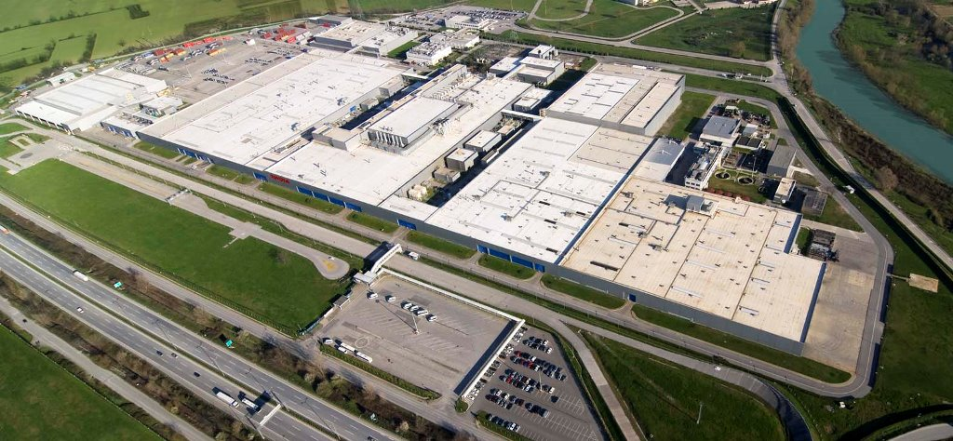
The DE-TA factory, which has been in operation since 1917, was renamed the Turkish Agricultural Equipment Institution (TZDK) in 1943 following legal changes made to support agriculture. Initially producing horse-drawn carriages, the factory manufactured Turkey's first assembled tractor in 1968. It was later renamed Başak Tractor Factory and relocated along the E-5 highway.
The second major factory in the region is the Military Heavy Maintenance and Repair Factory, initially established in Çorlu in 1934 but relocated near the railway in Adapazarı in 1943 for security reasons. Initially responsible for repairing all weapons and equipment for the Land Forces, it eventually became an important facility producing a wide range of defense equipment.
By the 1950s, as a result of policies aimed at spreading industry throughout the country, large public industrial establishments were also located in Adapazarı. These included the TCDD Wagon Factory, established in 1951, and the Sugar Factory, established in 1953. Strengthened by private sector investments, the industry in Sakarya initially developed in line with its agricultural resource potential.
Significant developments in the industrial sector occurred in Sakarya, especially after the 1990s. Investments by companies operating in the automotive and related sectors, such as Otokar, Tırsan, Asaş, Toyota, Türk Traktör, Başak Traktör, and Goodyear, have contributed to the industrial growth of the province.

Slide 22
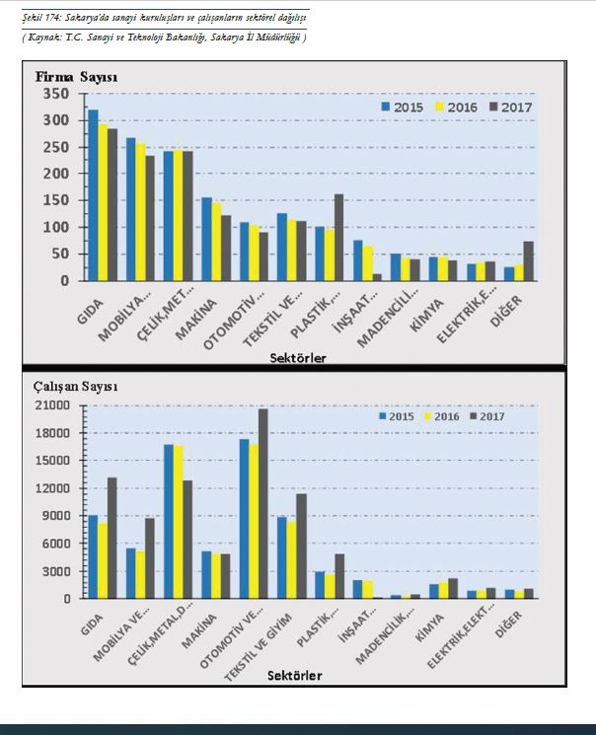
In recent years, Sakarya has been involved in the production of defense industry projects such as the national tank, armored combat vehicles, and the Fırtına howitzer, as well as rail system vehicles through TÜRASAŞ (formerly TÜVASAŞ). Sakarya's latest ambition is to become the production center for the national tank and domestic automobile.
In addition to the automotive sector and its sub-industries, Sakarya stands out in the production of armored security vehicles, steel, metal, chemical industry products, machinery and machine parts, electrical materials, furniture and forest products, textiles, food, ornamental plants, agricultural products, and poultry.
In the "Top 500 Industrial Enterprises in Turkey" list by the Istanbul Chamber of Industry, 17 companies from Sakarya were included in 2012, while in 2017, 9 companies headquartered in Sakarya (1 public) and 20 companies with branches in Sakarya were listed.
Excluding agricultural-based specialized organized industrial zones, there are 7 organized industrial zones in the province.

Slide 23
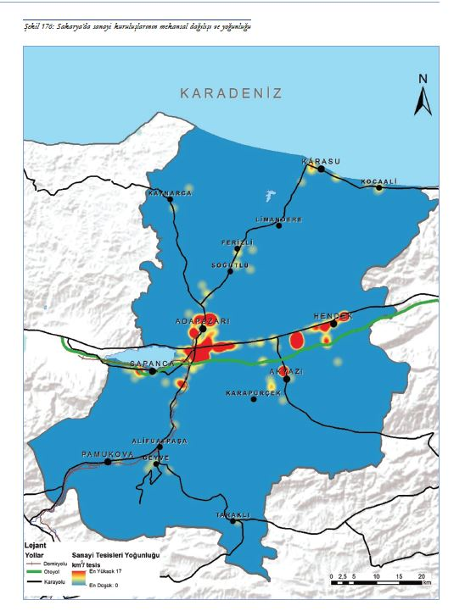
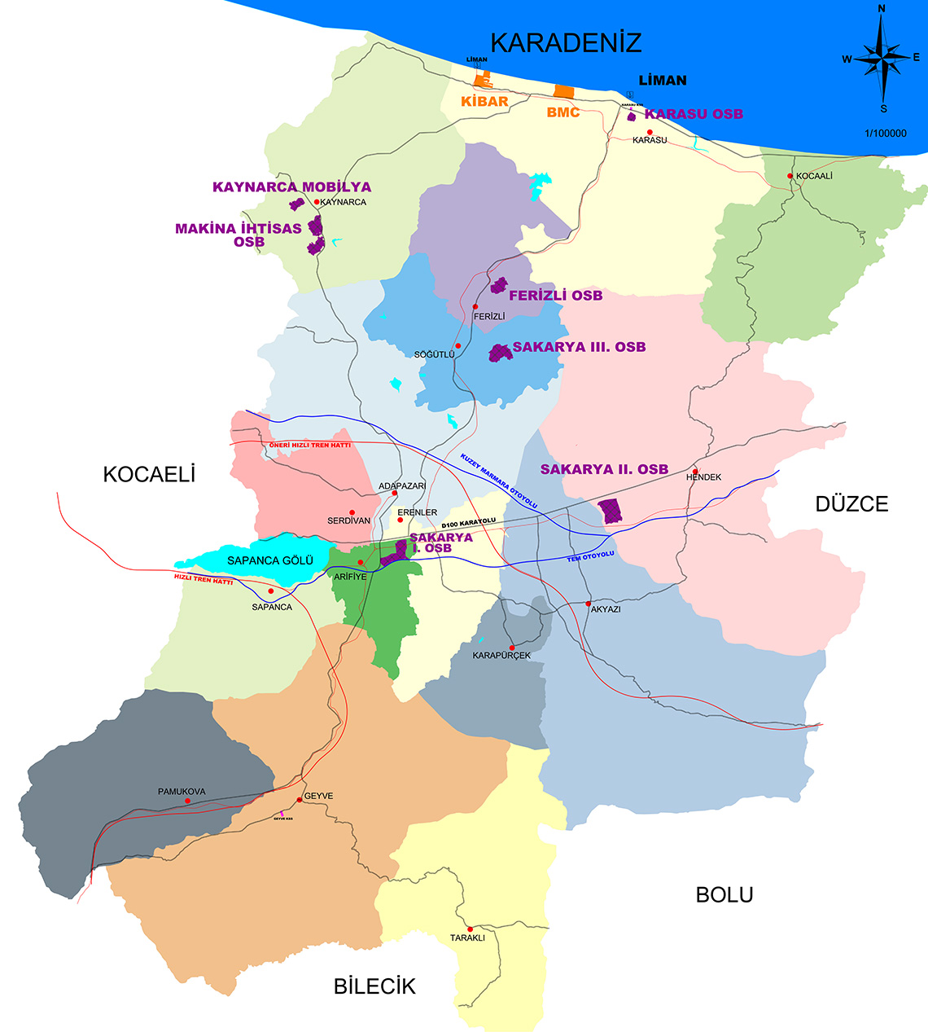

Slide 24
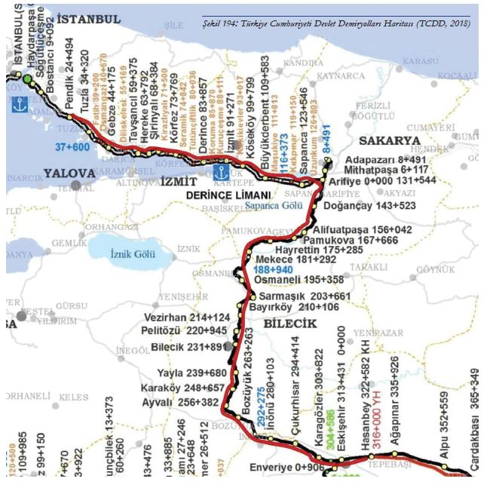
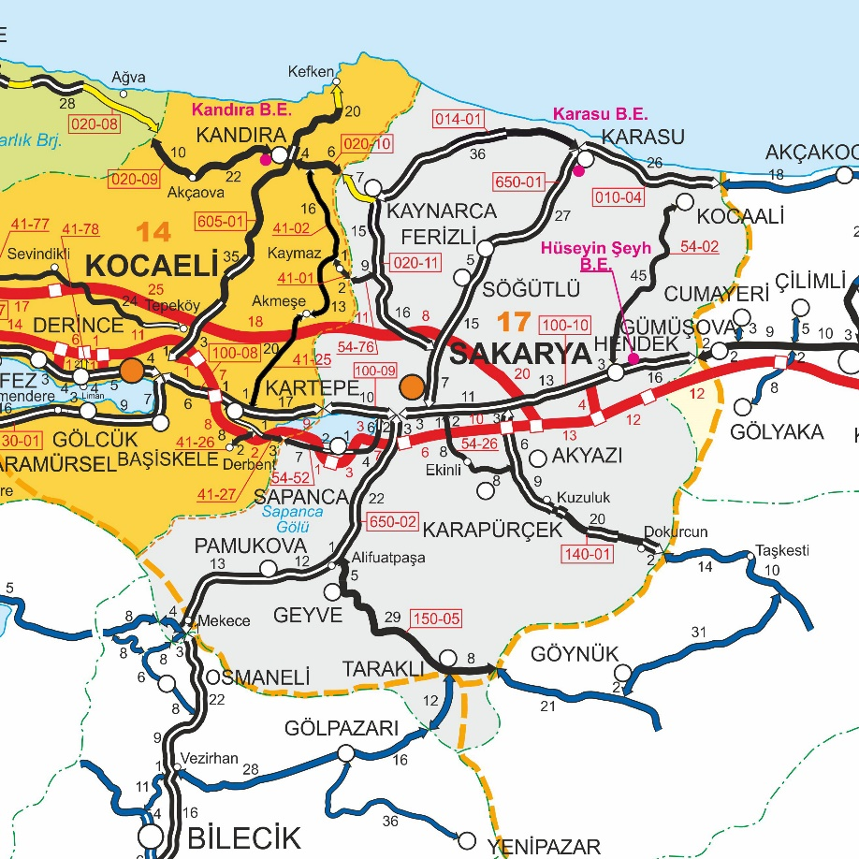
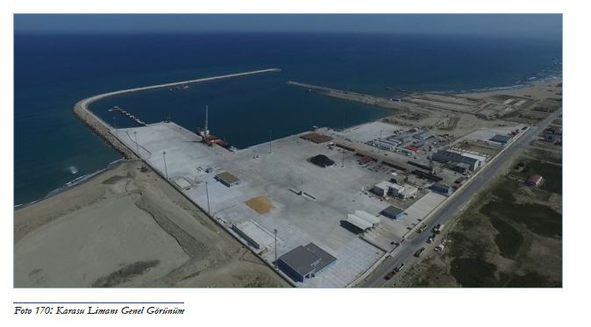
TRANSPORT
Turkey's highest traffic density occurs between the Marmara Region and other regions of Anatolia. The TEM motorway and the D-100 (E-5) highway, which serve as main arteries of this density, as well as the high-speed train line connecting Istanbul and Ankara, pass through Sakarya. The activation of Karasu Port has also highlighted Sakarya in terms of transportation, logistics, and attracting investment via sea routes.

Slide 25
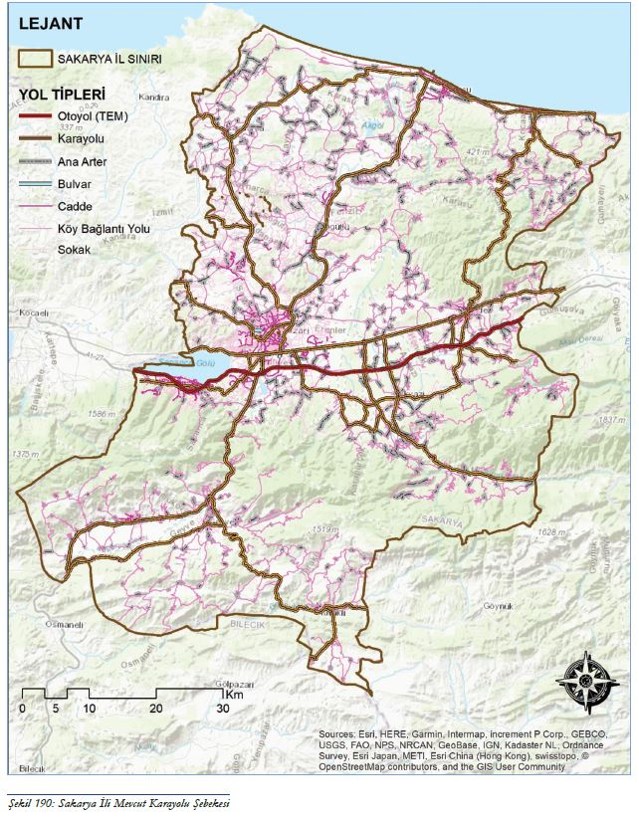
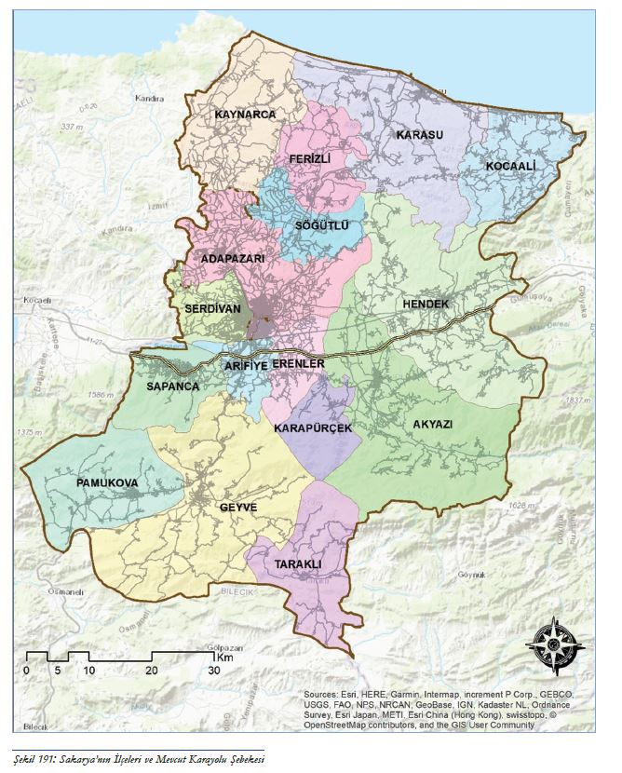
TRANSPORT

Slide 26
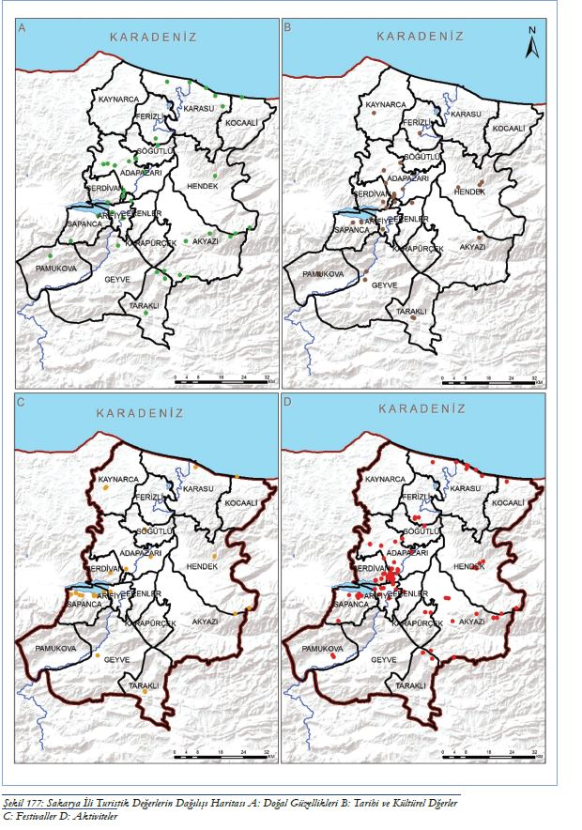
TOURISM
With its geographical location, Sakarya offers highly favorable opportunities for tourism activities. Due to humid climate conditions and abundant rainfall, the natural environment (forest, lake, river, waterfall, plateau, etc.) displays a rich diversity, while the city's coastline along the Black Sea enhances its significance for coastal and marine tourism.
Sakarya and its surroundings have hosted significant civilizations throughout history. The districts located along historical transportation routes and the cultural diversity brought by immigrants from the Balkan Peninsula, the Caucasus, and the Black Sea Region, along with the indigenous Manav culture, have also contributed to the development of cultural tourism.
Thanks to its geological features, Sakarya also benefits from health tourism (thermal springs), which adds value to the city’s tourism sector.
In addition to its diverse tourism offerings, the proximity to Istanbul, a densely populated city with significant industry and service sectors, and its neighboring Kocaeli are important factors in the development of tourism. Sakarya’s close proximity to other major cities in Turkey, such as Ankara, Bursa, and Eskişehir, further enhances its tourism potential. Additionally, Sakarya's position as a crossroads for east-west and north-south transit routes in Turkey contributes positively to its tourism.

Slide 27
Parks and Recreation Areas: Kent Park (Adapazarı), Yenikent Park (Adapazarı), Ormanpark (Adapazarı), Macerapark (Adapazarı), Korucuk Park (Adapazarı), Serdivan Gölpark (Serdivan), Kuzuluk Nature Park (Akyazı), Arifiye Göl Park (Arifiye), Poyrazlar Nature Park (Adapazarı), Sakarya Park (Erenler)
Plateaus: Acelle Plateau (Akyazı), Davlumbaz Plateau (Akyazı), Güzlek Plateau (Akyazı), Sultanpınar Plateau (Akyazı), Çiğdem Plateau (Hendek), Soğucak Plateau (Sapanca), Dikmen Plateau (Hendek), Karagöl Plateau (Taraklı), Yanık Plateau (Taraklı), Kırca Plateau (Geyve)
Lakes: Sapanca Lake, Acarlar Lake (Floodplain), Poyrazlar Lake (Adapazarı), Küçük Akgöl (Söğütlü), Büyük Akgöl (Ferizli)
Rivers, Streams, and Waterfalls: Sakarya River, Maden Stream and Waterfall, Doğançay Waterfall, Soğucak Waterfall, Harkköy Waterfall and Canyon, Istanbul Stream, Mahmudiye Stream, etc.
Coastal Tourism: Karasu, Kocaali, Kaynarca
Historical and Cultural Tourism: Taraklı, Justinianus Bridge/Beşköprü (Serdivan), Sakarya Bridge (Adapazarı), Sinan Bey Monastery/Elvanbey Almshouse (Geyve), Harmantepe Castle (Söğütlü), Seyifler Castle (Ferizli), Sakarya Museum (Adapazarı), Earthquake and Culture Museum (Adapazarı), Kuva-i Milliye Museum (Geyve-Alifuatpaşa), Yunus Pasha Mosque (Taraklı), Orhan Mosque (Adapazarı), Ağa Mosque (Adapazarı), Rüstempaşa Mosque (Sapanca), Rahime Sultan Mosque (Sapanca), Sheikh Müslihiddin Mosque (Kaynarca, Şeyhler Village), Büyük Esence Orhan Mosque, Hasan Fehmi Pasha Mosque (Sapanca), Bayezid II Bridge (Geyve-Alifuatpaşa), Vecihi Gate (Sapanca)

Slide 28
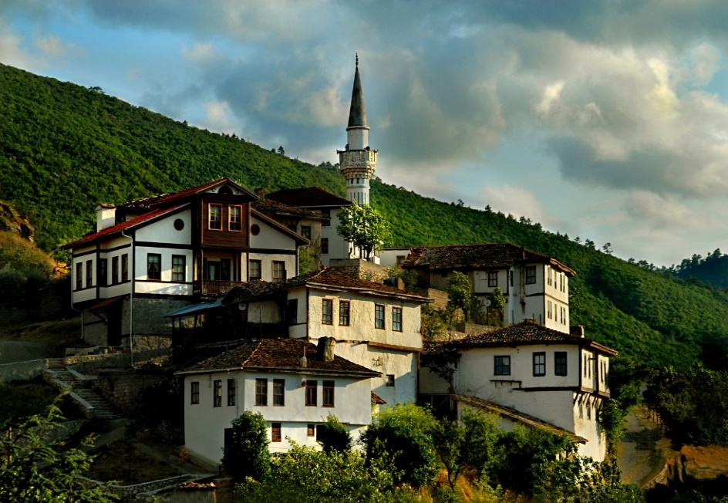
Archaeological Sites
Natural Protected Areas
Urban Protected Areas
Serdivan: Beşköprü - Justinianus Bridge
Söğütlü: Akarca Village (Roman Necropolis)
Hendek: Yağbasan Tumulus, Üçtepeler Area
Adapazarı: İkizce Village (Roman Necropolis)
Geyve: Kulfalar Village (Ortaköy Area)
Pamukova: Akçakaya Village
Taraklı: Center
Pamukova: Hayrettin Village (Menete Area)
Serdivan: Beşköprü Hakikat Foundation Cooperative
Serdivan: İstiklal Neighborhood, Altınışık Street, Plot 468, Parcels 1-2-3
Sakarya Center: Alandüzü Village, Bağdere Area
Taraklı-Center
Center-Uzun Bazaar
Taraklı-Center
Sapanca-Vakıf Hotel Road
Sapanca-Kırkpınar Surroundings
Arifiye-Sapanca
Sapanca-Akçay-Fevziye Village
Center-Poyrazlar Lake and Surroundings
Center-Hanlı Town
Sapanca-Kurtköy Picnic Area
Karasu-Acarlar Lake and Longoz Forest
Söğütlü-Akgöl Village-Akgöl Location
Karasu-Kocaali districts Maden Creek Location
Health Tourism
Kuzuluk Thermal Springs (Akyazı)
Taraklı Thermal Springs (Taraklı)

Slide 29

TURİSTİK YERLER
https://www.kulturportali.gov.tr/turkiye/sakarya/gezilecekyer

Slide 30


Slide 31


Slide 32


Slide 33


Slide 34


REFERENCE
SAKARYA BOOK
https://acikerisim.sakarya.edu.tr/handle/20.500.12619/96335

